Slide 2

Active Thermography to Determine Grape Bud Mortality: System Design and Feasibility
Guangxun ZHAI¹, Justine VANDEN HEUVEL², Steven LERCH², Yu JIANG²
1 School of Electrical and Computer Engineering, Cornell University
2 School of Integrative Plant Science, Cornell University
Presented for 2023 GiESCO, July 19, 2023

Slide 3
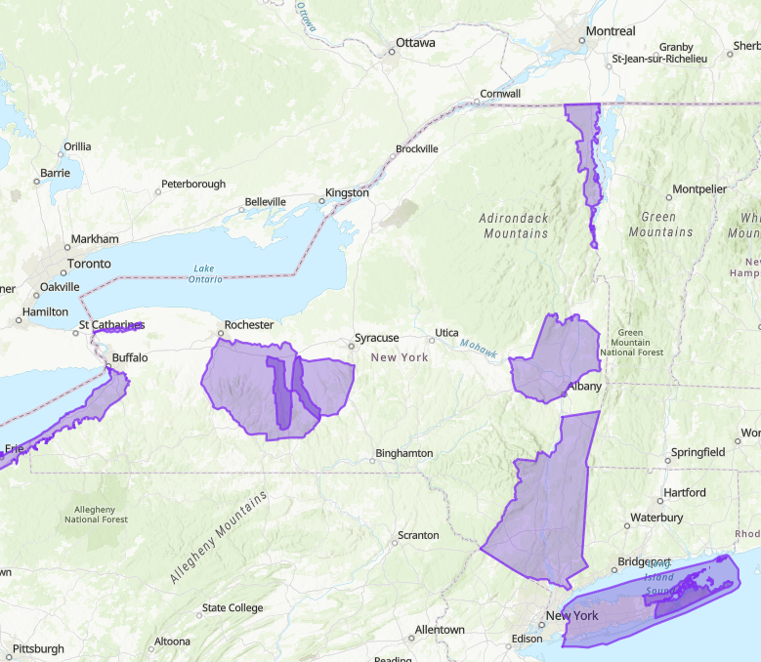
Cold Damage
Reported up to 100 percent loss due to frost events
Huge economic losses to NYS winegrowers and grape wine industry
More often in recent years
Up to 80% losses in Finger Lakes region in 2014
Constantly across NYS in 2022 and likely 2023
Wine grape production regions in NYS
*Map is generated via Alcohol and Tobacco Tax and Trade Bureau: https://www.ttb.gov/wine/ava-map-explorer

Slide 4
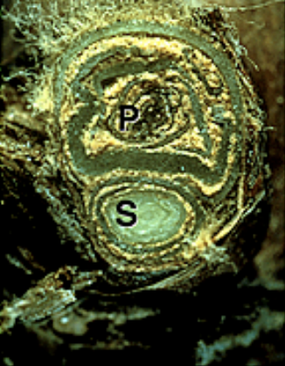
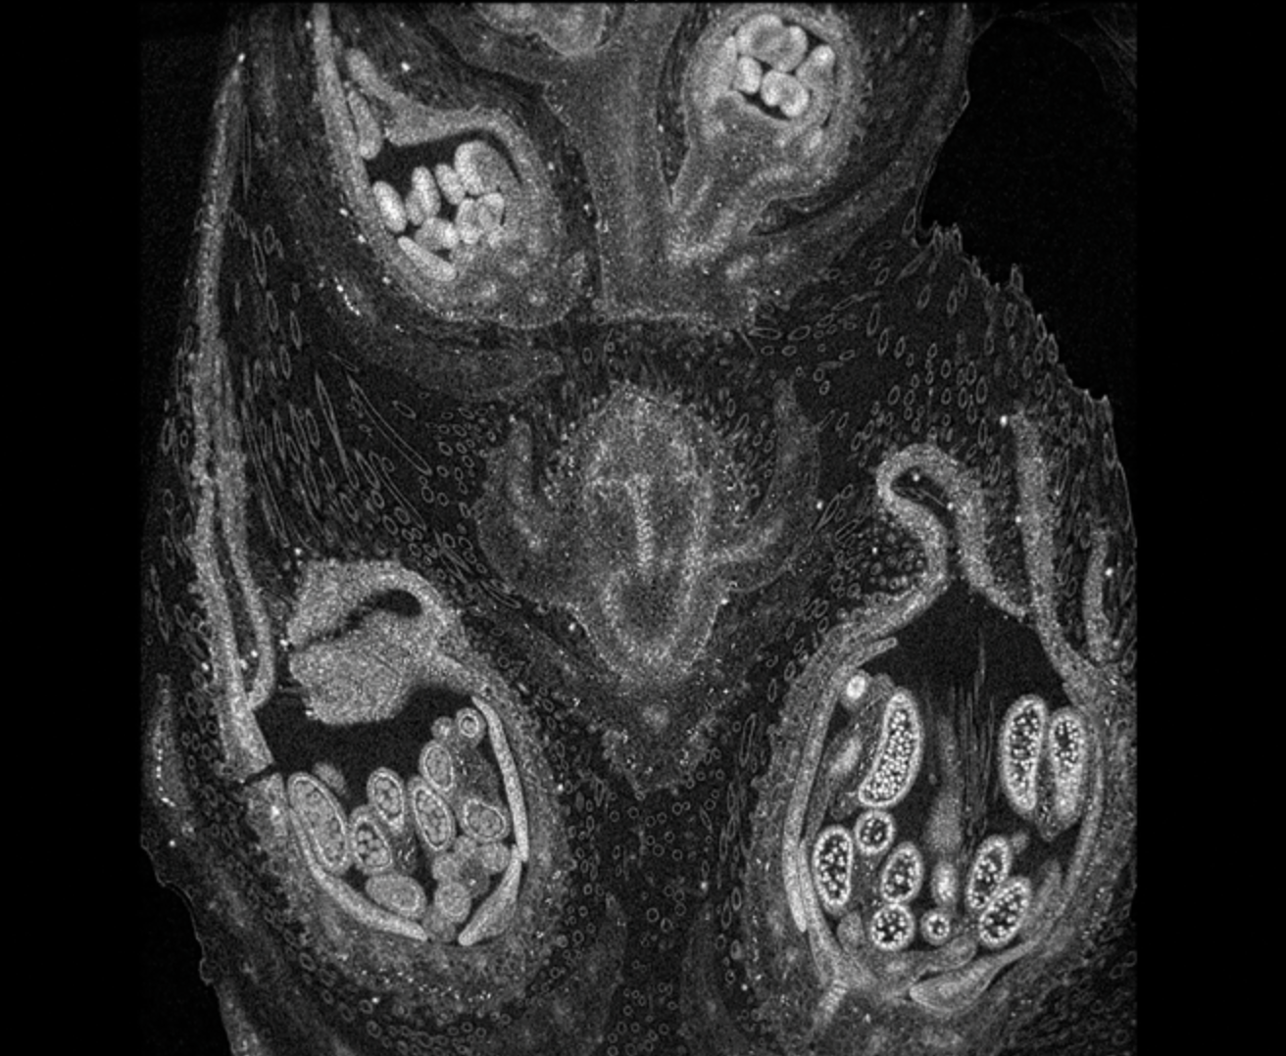
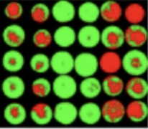
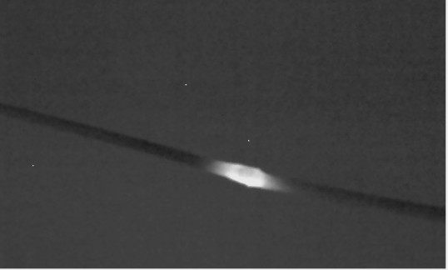
How to Sense Bud Damage?
 | Manual Examination (Random Sampling & Slicing) | Computed Tomography/Magnetic resonance Imaging | Hyperspectral Imaging | Active Thermography System
Affordability | ✘​ | ✘​ | ✔​ | ✔
Accuracy | ✘​ | ✔ | ✘ | ✔
Sensitivity | High | High | Low | Medium

Slide 5
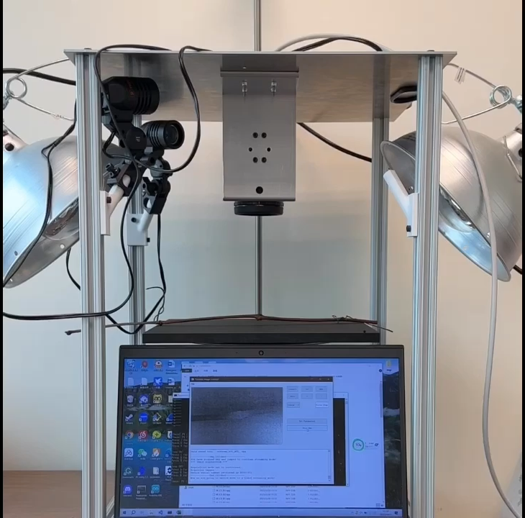
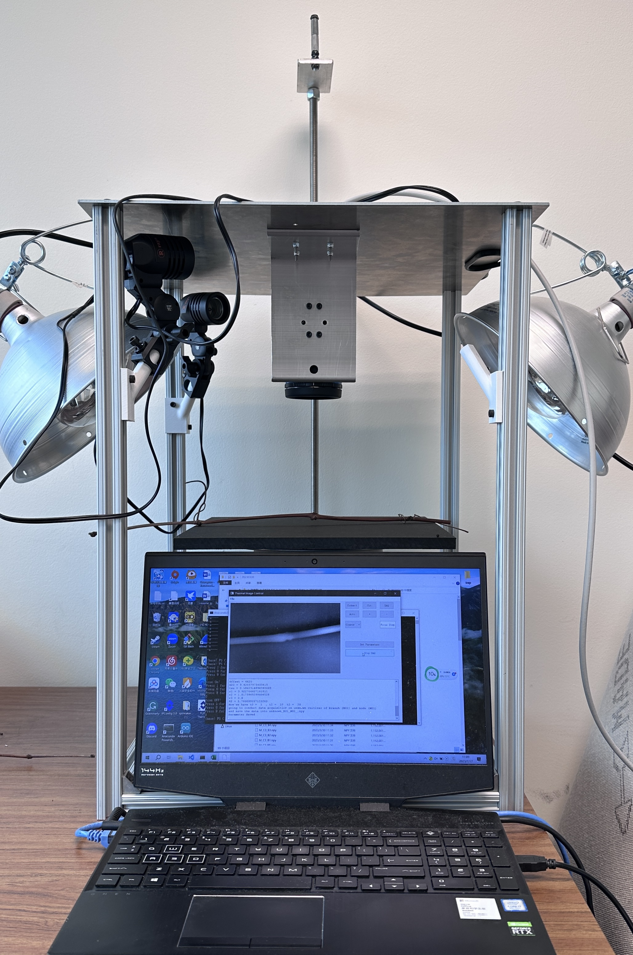
System Design
Overview of the System

Slide 6
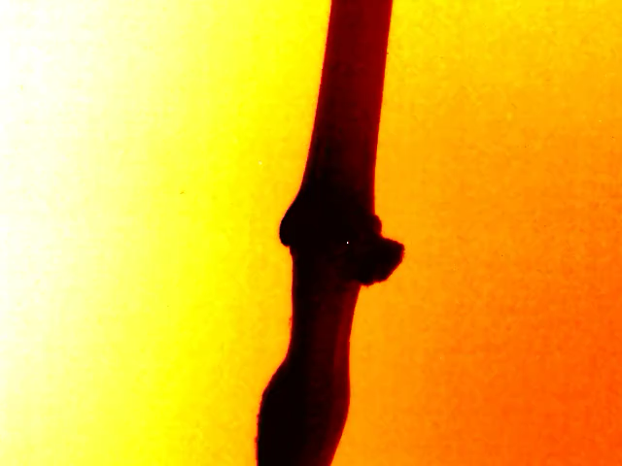
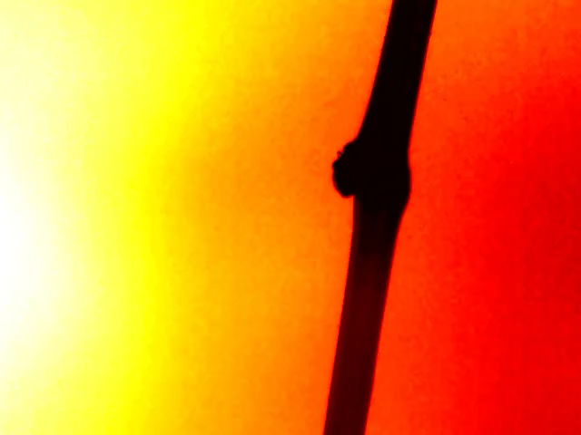
Example Thermal Videos
Thermal Changes of the Cayuga White (Left: Intact; Right: damaged)

Slide 7
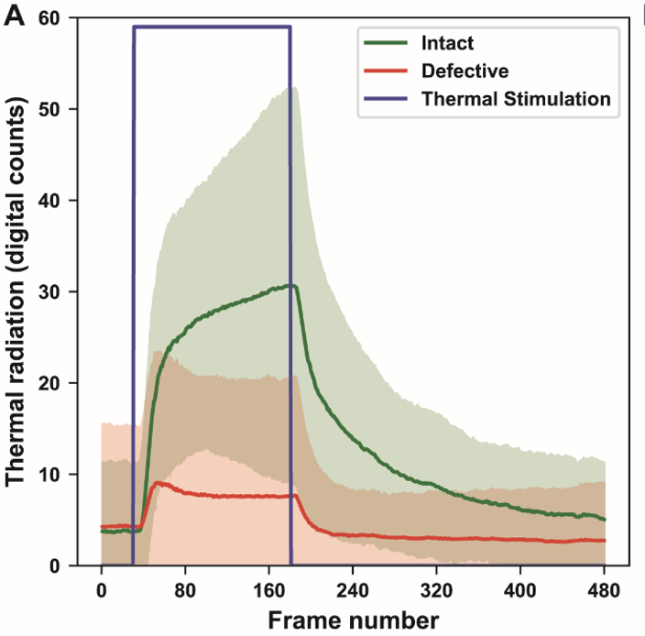
Thermal Conductivity Difference
Intact grape buds showed a higher peak temperature than damaged ones
Intact grape buds showed a higher thermal conductivity than damaged ones
Certain overlaps between intact and damaged grape buds

Slide 8
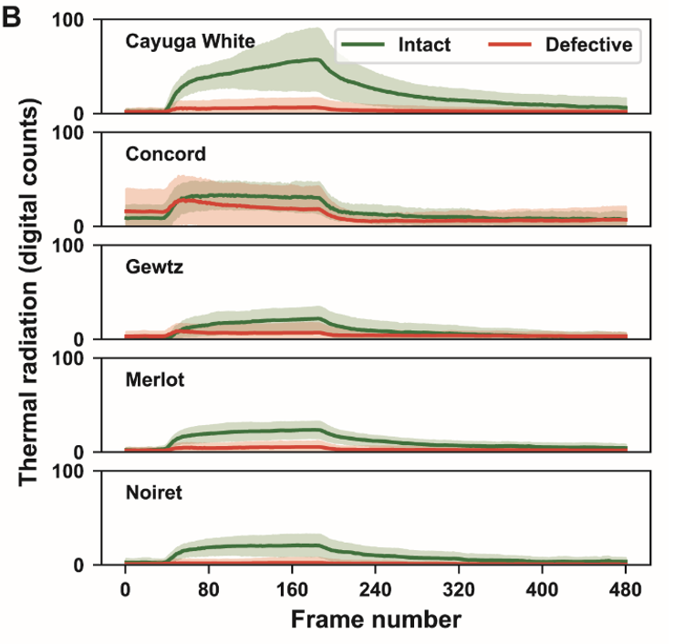
Cultivar Differences
In general, the tested cultivars showed similar responses to the external thermal stimulations
Cayuga White demonstrated the largest separation
Concord had the least separation between intact and damaged buds

Slide 9
Applications for Growers
Estimate bud mortality ratio
Precision pruning in vineyards
High throughput phenotyping for genetics studies and breeding
Crop insurance and other financial assistance programs

Slide 10

Acknowledgement
NEW YORK WINE & GRAPE FOUNDATION
Determining bud mortality via thermal imaging to guide pruning practices

Slide 11

Thanks for Your Attention! Questions?

